Slide 1

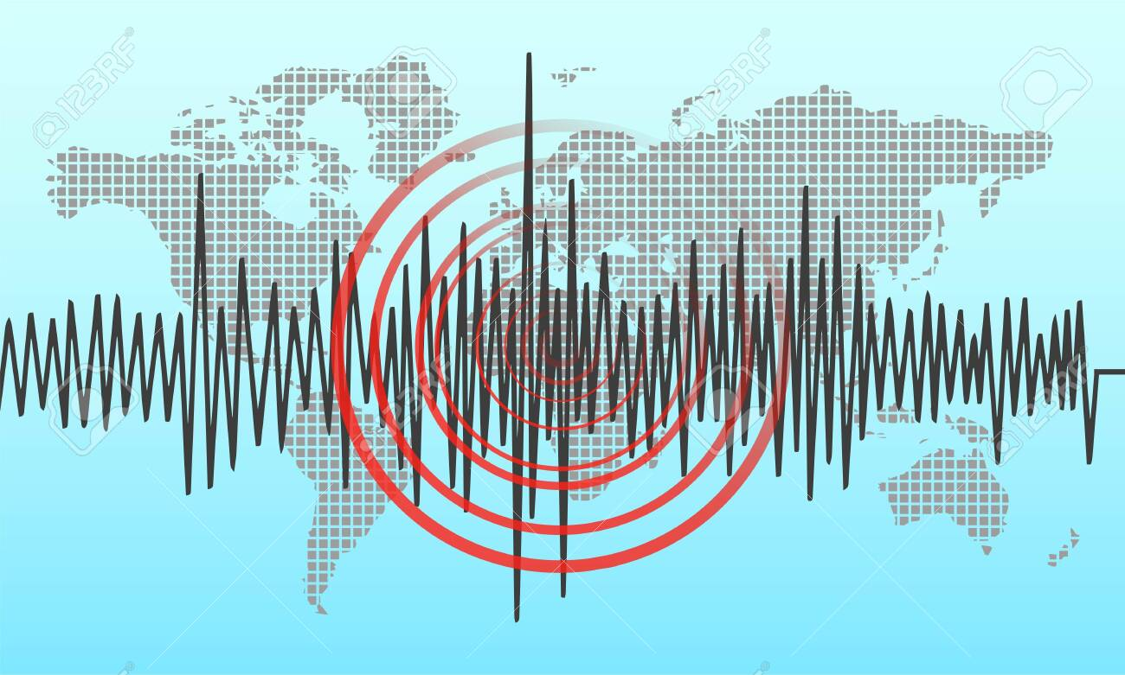
Earthquake Analysis
Department of Applied Data Science
Ahaz Bhatti ID: 011109033
Professor:
Andrew H. Bond

Slide 2
Overview
An earthquake is a vibration or shaking that occurs due to a shift or movement of the earth layer originating from the base of the earth's surface.
The dataset from USGS contains real-time data for earthquakes within the United States and has 22 variables that are updated every minute and contains past data as well.
Besides earthquakes there's also other types of quakes depending on the seismic activity.
There is about 20,000 earthquakes in the world each year according to The National Earthquake Information Center.
Real-data collected for earthquakes can only go back up to 30 days for analysis.

Slide 3
About the Dataset
depth- Depth of the event in kilometers. The depth where the earthquake begins to rupture.
depthError- Uncertainty of reported depth of the event in kilometers.
dmin- Horizontal distance from the epicenter to the nearest station (in degrees).
gap- The largest azimuthal gap between azimuthally adjacent stations (in degrees).
horizontalError- Uncertainty of reported location of the event in kilometers.
id- A unique identifier for the event. This is the current preferred id for the event, and may change over time.
latitude- Decimal degrees latitude. Negative values for southern latitudes.
locationSource- The network that originally authored the reported location of this event.
longitude- Decimal degrees longitude. Negative values for western longitudes.
mag- The magnitude for the event. Earthquake magnitude is a measure of the size of an earthquake at its source.
magError- Uncertainty of reported magnitude of the event.
magNst- Total number of seismic stations used to calculate the magnitude for earthquake.

Slide 4
Continued
magSource- Network that originally authored the reported magnitude for this event.
magType- The method or algorithm used to calculate the preferred magnitude for the event.
net- The ID of a data contributor. Identifies the network considered to be the preferred source of information for this event.
nst- The total number of seismic stations used to determine earthquake location.
place- Textual description of named geographic region near to the event.
rms-The root-mean-square (RMS) travel time residual, in sec, using all weights.
status- Indicates whether the event has been reviewed by a human. Status is either automatic or reviewed. Automatic events are directly posted by automatic processing systems. Reviewed events have been looked at by a human.
time- Time when the event occurred. Times are reported in milliseconds.
type- Type of seismic event.
updated- Time when the event was most recently updated. Times are reported in milliseconds since the epoch

Slide 5
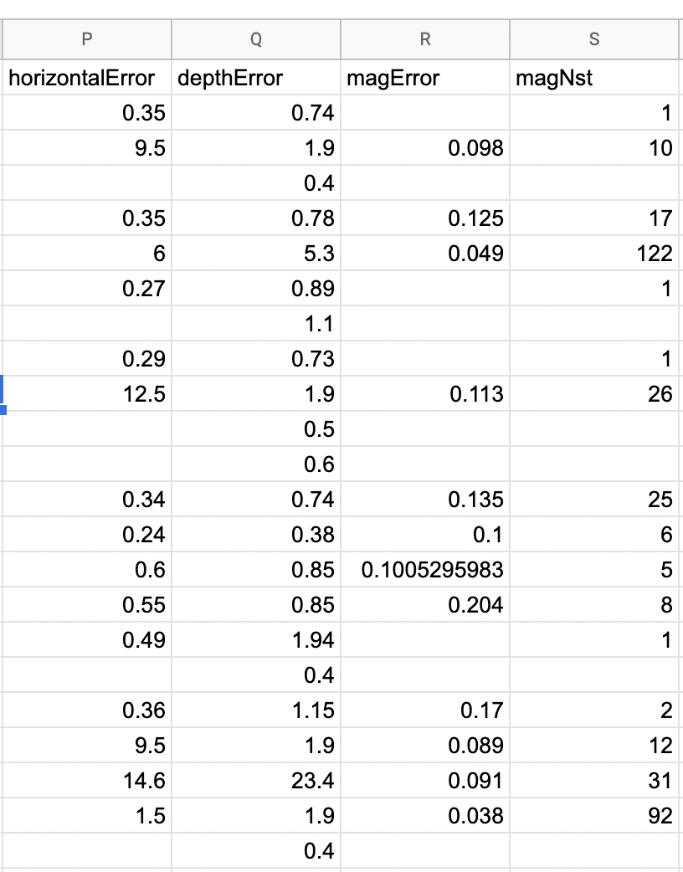
Data Preparation
This is a live dataset, so it’s hard to perform data preparation.
Capitalized all columns and renamed some columns such as (mag) to (Magnitude).
Changed (depth) to (Depth km) to understand which measurement is being used.
Some changes I would fix in tableau prep builder is remove rows with many missing values and remove outliers.

Slide 6
Api Connection to Tableau
Visit earthquake.usgs website and choose which duration of live data fits your project needs.
Select the API url for the live data and open Google Spreadsheet and use the import data function and paste URL.
Go to Tableau and connect it to your Google Spreadsheet to receive real time data.
Tableau needs to connect to API each time it is closed and open again and authenticated with Google account where live data is hosted

Slide 7
Visualizations Created for the project
Geospatial map containing real time earthquakes around the globe.
Type of seismic event.
Places containing the earthquakes with their respective magnitude
Magnitude vs Depth
Which is method used to calculate the magnitude for depth.
Earthquake reviewed by system or human

Slide 8
Visualizations Created for the project
7. Horizontal Error for each location where Earthquake occurred
8. Depth Error for Depth, how much error is calculated for each earthquake Depth
9. Magnitude Error for Magnitude, how much error is calculated for each earthquake Magnitude
10. The root-mean-square for Magnitude.
11. Geospatial map containing seismic stations and and location source

Slide 9

Visualizations done on Tableau

Slide 10
References
https://earthquake.usgs.gov/earthquakes/feed/v1.0/csv.php
https://www.kaggle.com/code/farazrahman/earthquakes-induced-quakes-know-the-difference/notebook
https://www.usgs.gov/faqs/why-are-we-having-so-many-earthquakes-has-naturally-occurring-earthquake-activity-been#:~:text=The%20National%20Earthquake%20Information%20Center,or%20approximately%2055%20per%20day.

